Slide 1

[Samsung PRISM] Mid Review Report
Classification of Video into Actions and Events - Group Activity
College Professor(s): Dr. J Sangeetha, Dr. Deepali Koppad
Students:
ROJA
S SPANDANA
JASWANTH
MADHURA C S
3.Department: Department of CSE and ECE
Date: 17.06.2020

Slide 2
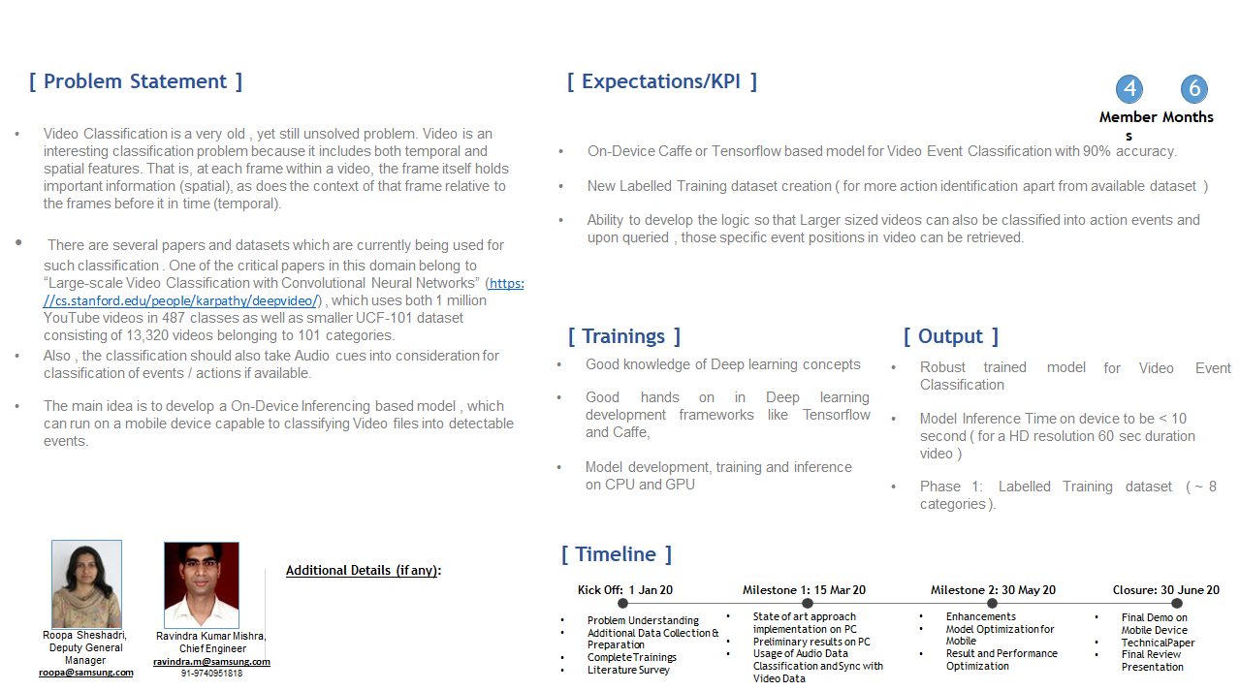




Information Retrieval | SQL to Lucene Query Parser
Problem Statement
Lucene is a High Performance Text Search Engine implemented in Java.
The Query to search Text has to be created using Lucene APIs .
There have been limited attempts to use SQL for forming Lucene Queries. While SQL query is quite famous among developers but lucene query not.
When giving Lucene engine API for text retrieval engine to 3rd party there is learning curve from the developer end to adapt the Lucene query which can cause the integration delay.
The problem statement is to create a module which can take SQL queries as Input and Output an equivalent Lucene Query in real time processing speed so that developer can use the lucene engine without learning new query syntax (lucene in this case)
This will create the abstraction which allow less coupling with any indexing engine.
Expectations
A java library with API (s) to take SQL text query as Input and return a valid equivalent Lucene Query. Mapping Simple and Complex SQL queries to Lucene Query
The SELECT, UPDATE, INSERT and DELETE APIs should be implemented.
Sufficient level of argument complexity should be taken care of. (e.g. Range Query with BETWEEN etc.)
Automatic Unit Test cases running various combinations of SQL Queries and Testing Lucene Query Equivalence.
API Document, Design Document, Implemented Project Code, Unit Test Report.
Training/ Pre-requisites
Trained in Java
Completed Courses:
Data Structures
Databases
Algorithms
Student Learning
Information Retrieval Concepts.
Lucence Text Search Engine Usage.
Design of Interfaces.
Test Driven Development.
[ INSERT YOUR WORK-LET TEMPLATE HERE ]
2
Members
Additional Documentation:
Lucene:
https://lucene.apache.org/
SQL To Lucene Sample :
https://github.com/bbejeck/sql-for-lucene
Srevatsa, Director
srevatsa@samsung.com
Vanraj, Manager
vanraj.vala@samsung.com
Kick Off 15 Sep 18
Understand Lucene
Implement Lucene Queries
Milestone 1 15 Oct 18
Basic Select Statements to Lucene Query working with projection and selection args.
Milestone 2 15 Nov 18
Insert , Update and Delete SQL Query to Lucene Query Working
Test Case Report
Closure 31st Dec 18
Project Report
Test Case Report
Demonstration
Notes:
-

Slide 3
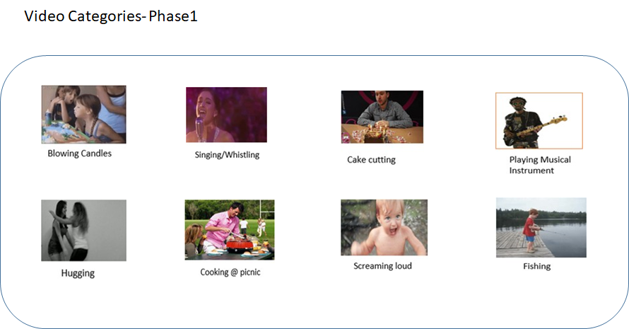

Slide 4
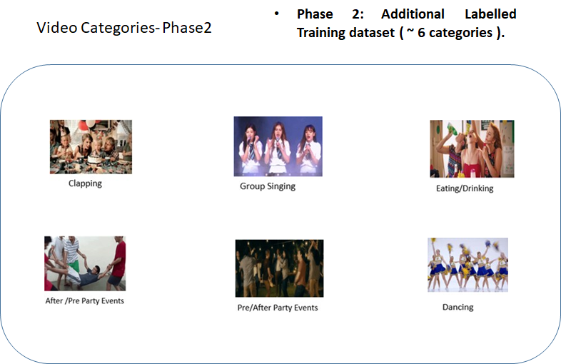

Slide 5
Dataset(s) Analysis / Description
Dataset Capture / Preparation / Generation :
Some of the videos were generated and some were downloaded from shuttershock.com, https://serre-lab.clps.brown.edu/resource/hmdb-a-large-human-motion-database/#overview, youtube.com
The classes that the data contain are hugging, laughing, cakecuting, screaming, blowing candles
Dataset Understanding / Analysis :
Dataset is not uniform.
Some of the videos in dataset has no audio.
Some of the videos in dataset has noise.
Dataset Pre-Processing / Related Challenges (if any) :
Extracting the frames.
Resizing the frames.
Difficulties faced:
Accessing all the dataset collected from the team members which are uploaded to the google drive requires a large amount of internet connectivity both to upload and to download.

Slide 6
Total number of Videos Collected:
The google drive link: https://drive.google.com/drive/u/0/folders/1JvgsT08YpXjOcPW_YP5P6pY47Jy36Gzz
Blowing candles 192
Cake cutting 285
Hugging 165
Laughing 547
Screaming loud 427
Total number of frames extracted are 9600
1502 frames on Blowing candles.
1850 frames on Cake cutting
1488 frames on screaming
3606 frames on laughing
1150 frames on hugging

Slide 7
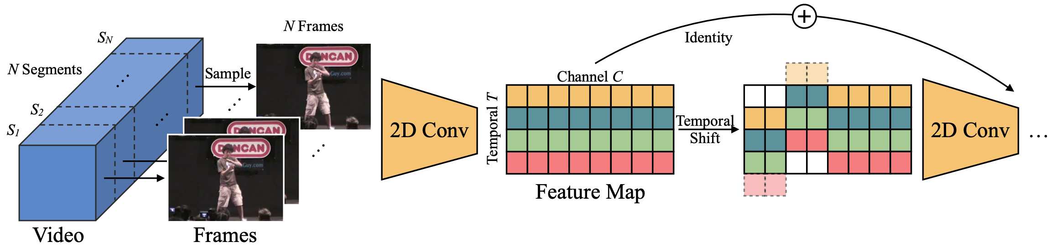
Proposed Approach / Solution
MIT ²MIT-IBM Watson AI Lab
Concept Diagram :
Reference: TSM: Temporal Shift Module for Efficient Video Understanding
Authors: Ji Lin MIT(jilin@mit.edu) Chuang Gan( MIT-IBM Watson AI Lab ganchuang@csail.mit.edu) Song Han MIT (songhan@mit.edu)

Slide 8
Models we implemented before we were informed to focus on tsm model.
Vgg 16(completed till training)
Google inception v3(incomplete)
Resnet50(incomplete)
Mobilenet(incomplete)

Slide 9
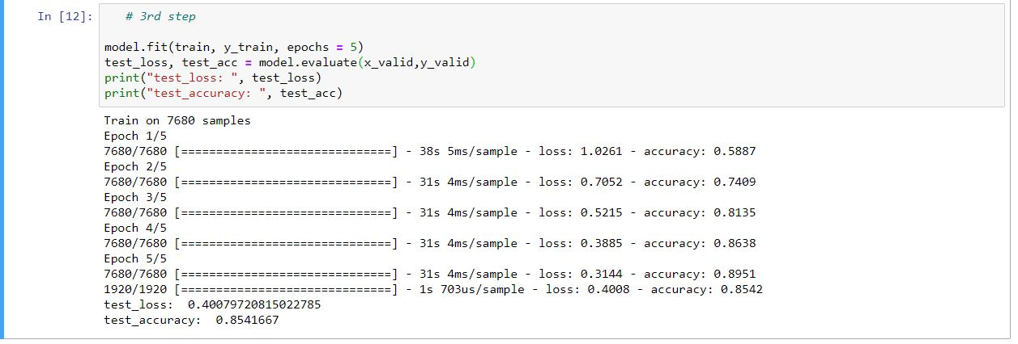
Experimental Results / Simulations / Observations
Results :
Results of VGG16 model training
We have stopped continuing with the models as we were told to concentrate only Temporal Shift Module (TSM).

Slide 10
Further Plan to Complete Project
Final Probable Deliverables :
Implement Temporal Shift Module which enables temporal reasoning, at the cost of zero parameters and zero flops.
Training the TSM model with MobileNetV2 as a backbone.
Testing the trained model.
Deploying the model on a device.

Slide 11
Further Plan to Complete Project
Completion Plan:
Week 1 to 2
Step 1 - Collecting more data
Step 2 - Analysing the code
Week 3 to 4
Step 1 - Preprocessing the data, extracting the frames
Step 2 - Generating the annotations needed for dataloader
Week 5 to 6
Step 1 - Training the model
Step 2 - Fine tuning the parameters if required
Week 7 to 8
Step 1 - Testing the model
Step 2 - Deploying the model on a device
Challenges Anticipated:
A device with good GPU might be required for computation.

Slide 12
Thank you

